Slide 1

Data-Intensive Distributed Computing
CS 451/651 431/631 (Winter 2018)
Part 1: MapReduce Algorithm Design (3/4)
January 11, 2018
Jimmy Lin
David R. Cheriton School of Computer Science
University of Waterloo
These slides are available at http://lintool.github.io/bigdata-2018w/
This work is licensed under a Creative Commons Attribution-Noncommercial-Share Alike 3.0 United States See http://creativecommons.org/licenses/by-nc-sa/3.0/us/ for details

Slide 2
Agenda for Today
Cloud computing
Datacenter architectures
Hadoop cluster architecture
MapReduce physical execution

Slide 3

Remember: Assignment 0 due 1pm Tuesday, January16 – You must tell us if you wish to take the late penalty.
Source: Wikipedia (The Scream)

Slide 4
Today
Data Science
Tools
This Course
Analytics Infrastructure
Execution Infrastructure
“big data stack”

Slide 5

Aside: Cloud Computing
Source: Wikipedia (Clouds)

Slide 6
The best thing since sliced bread?
Before clouds…
Grids
Connection machine
Vector supercomputers
…
Cloud computing means many different things:
Big data
Rebranding of web 2.0
Utility computing
Everything as a service

Slide 7
Rebranding of web 2.0
Rich, interactive web applications
Clouds refer to the servers that run them
Javascript! (ugh)
Examples: Facebook, YouTube, Gmail, …
“The network is the computer”: take two
User data is stored “in the clouds”
Rise of the tablets, smartphones, etc. (“thin clients”)
Browser is the OS

Slide 8
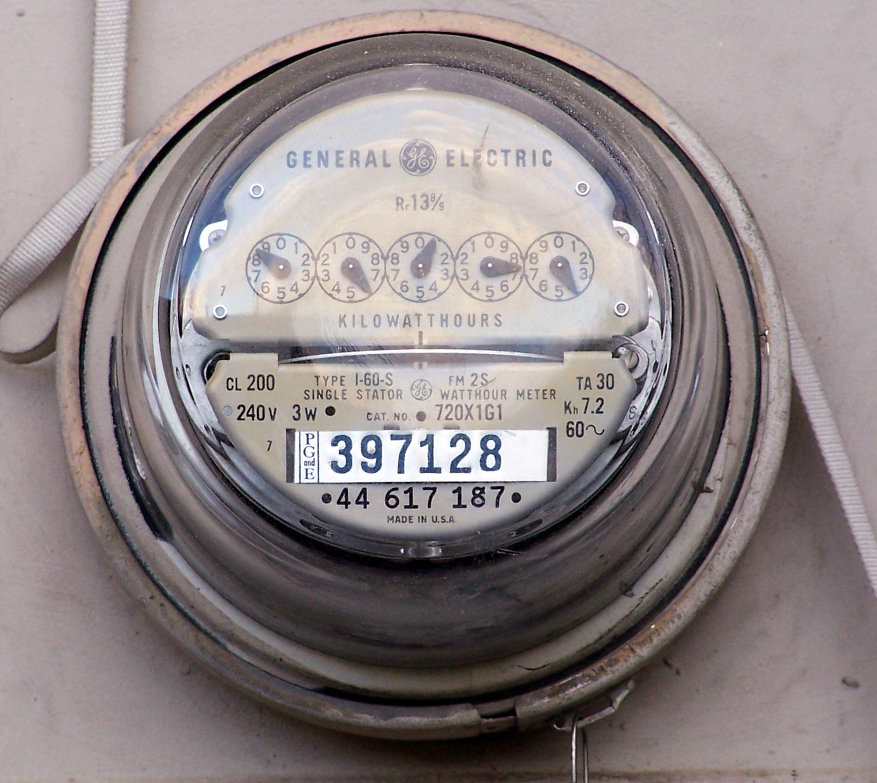
Source: Wikipedia (Electricity meter)

Slide 9
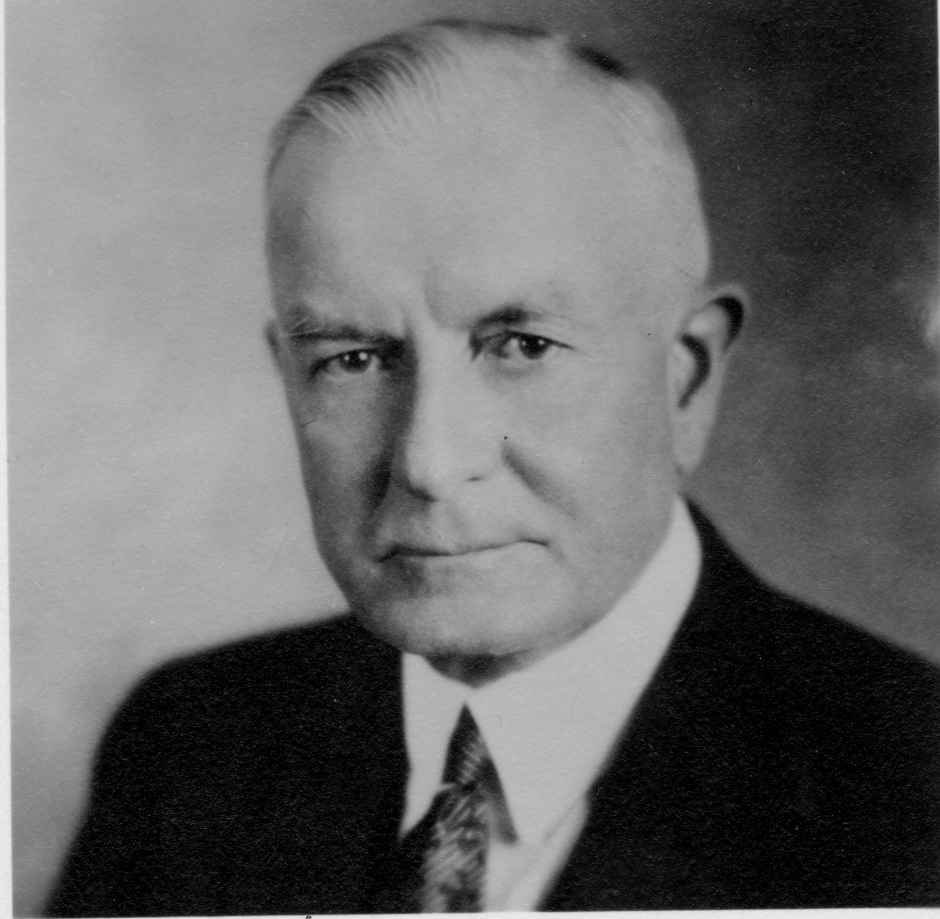
Utility Computing
What?
Computing resources as a metered service (“pay as you go”)
Why?
Cost: capital vs. operating expenses
Scalability: “infinite” capacity
Elasticity: scale up or down on demand
Does it make sense?
Benefits to cloud users
Business case for cloud providers
I think there is a world market for about five computers.

Slide 10
Evolution of the Stack
App
App
App
App
App
App
App
App
App
OS
OS
OS
Container
Container
Container
Operating System
Hypervisor
Operating System
Hardware
Hardware
Hardware
Traditional Stack
Virtualized Stack
Containerized Stack

Slide 11
Everything as a Service
Infrastructure as a Service (IaaS)
Why buy machines when you rent them instead?
Examples: Amazon EC2, Microsoft Azure, Google Compute
Platform as a Service (PaaS)
Give me nice platform and take care of maintenance, upgrades, …
Example: Google App Engine, Altiscale
Software as a Service (SaaS)
Just run the application for me!
Example: Gmail, Salesforce

Slide 12
Everything as a Service
Database as a Service
Run a database for me
Examples: Amazon RDS, Microsoft Azure SQL
Container as a Service
Run this container for me
Example: Amazon EC2 Container Service, Google Container Engine
Function as a Service
Run this function for me
Example: Amazon Lambda, Google Cloud Functions

Slide 13
Who cares?
A source of problems…
Cloud-based services generate big data
Clouds make it easier to start companies that generate big data
As well as a solution…
Ability to provision clusters on-demand in the cloud
Commoditization and democratization of big data capabilities

Slide 14
So, what is the cloud?
Source: Wikipedia (Clouds)

Slide 15

What is the Matrix?
Source: The Matrix - PPC Wiki - Wikia

Slide 16

Source: The Matrix

Slide 17
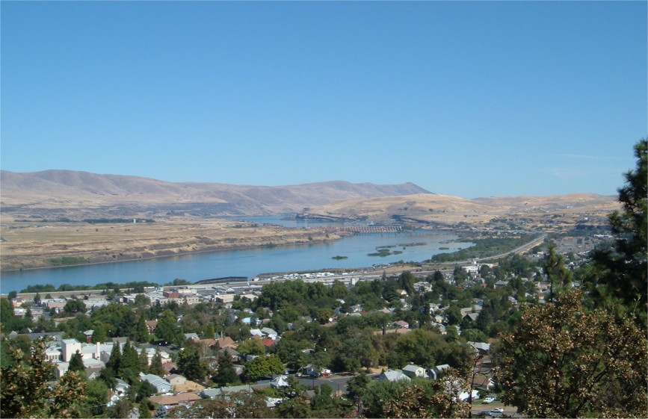
Source: Wikipedia (The Dalles, Oregon)

Slide 18
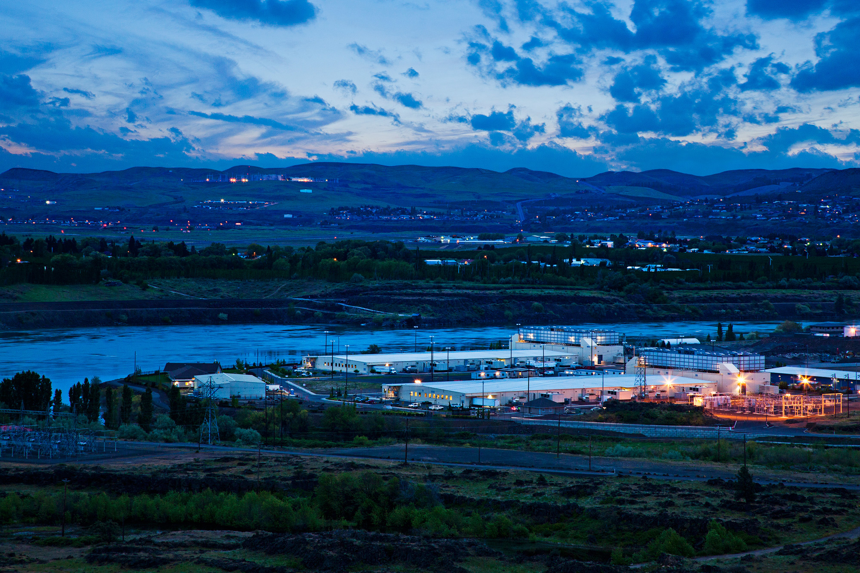
Source: Google

Slide 19
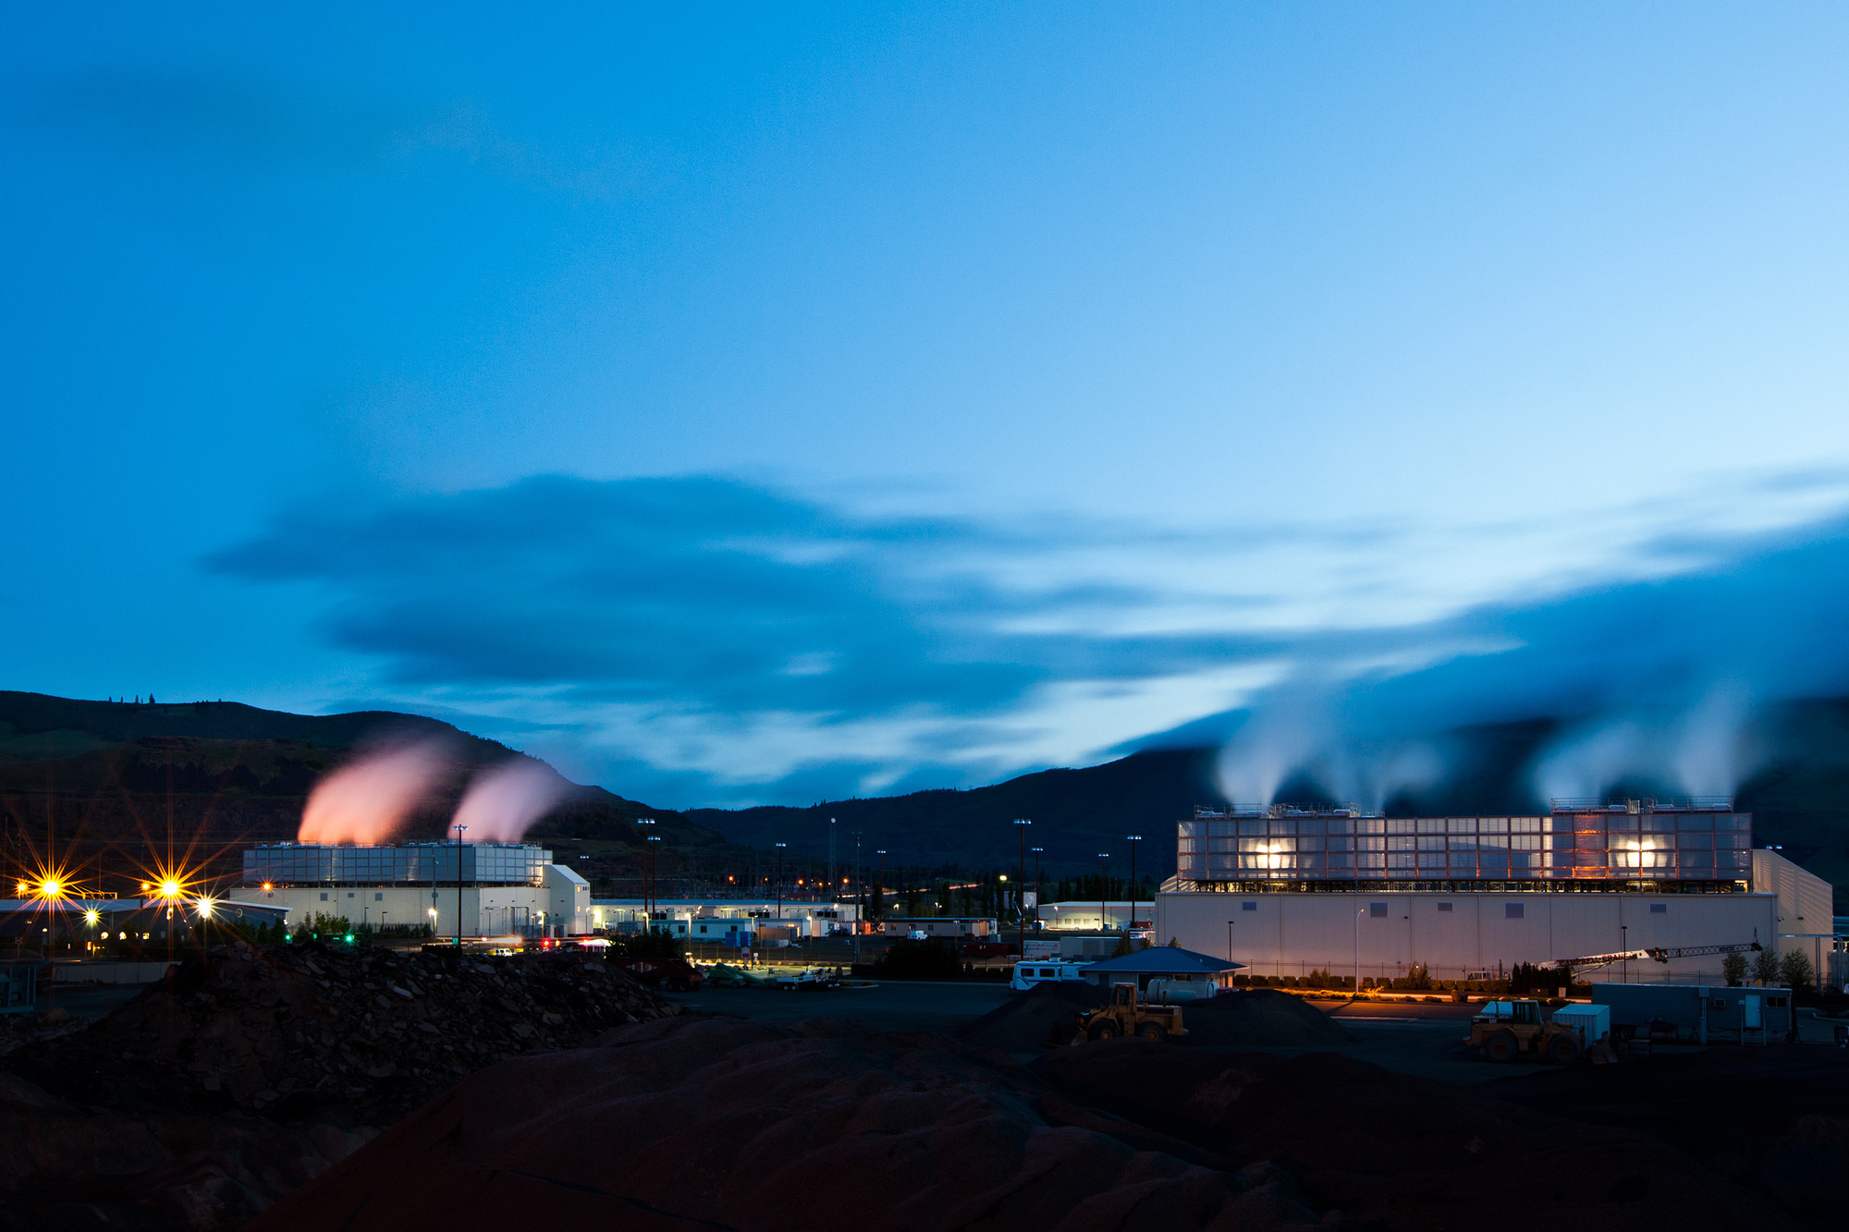
Source: Google

Slide 20
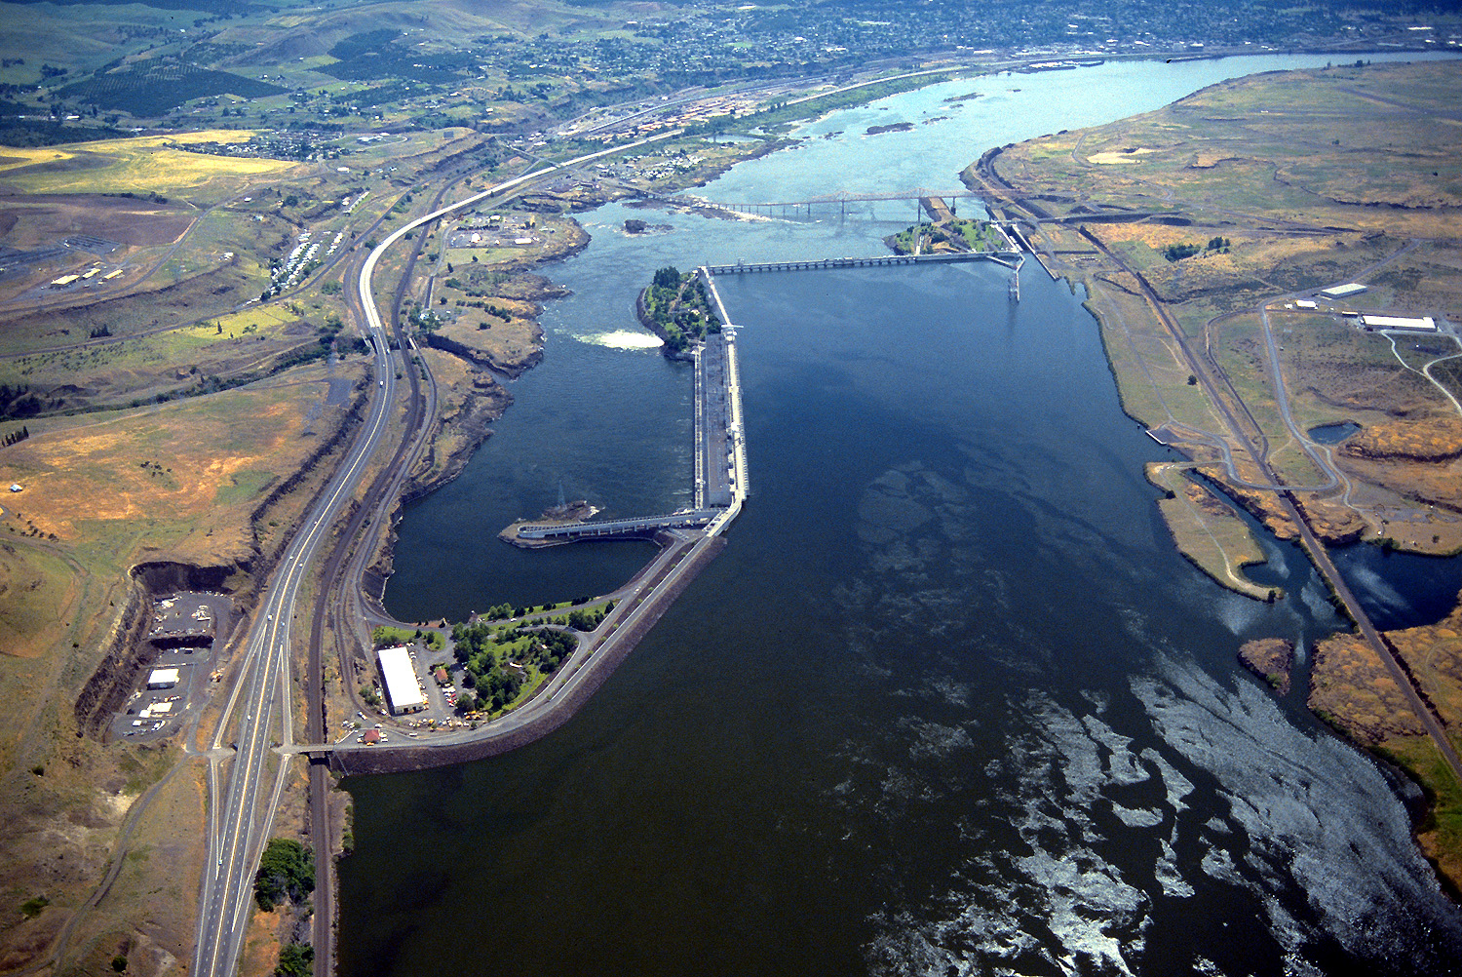
Source: Bonneville Power Administration

Slide 21
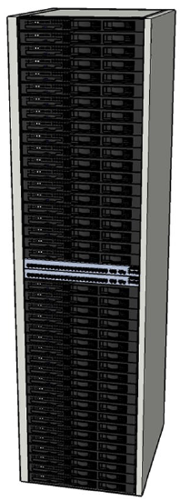
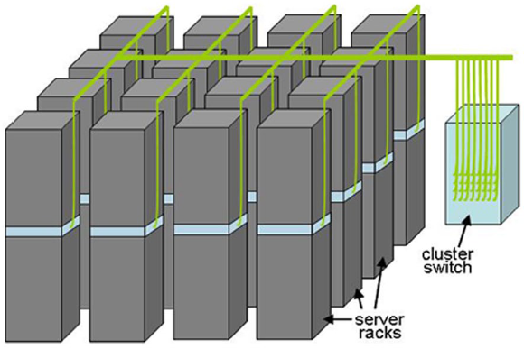
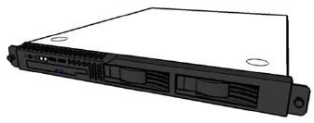
Building Blocks
Source: Barroso and Urs Hölzle (2009)

Slide 22
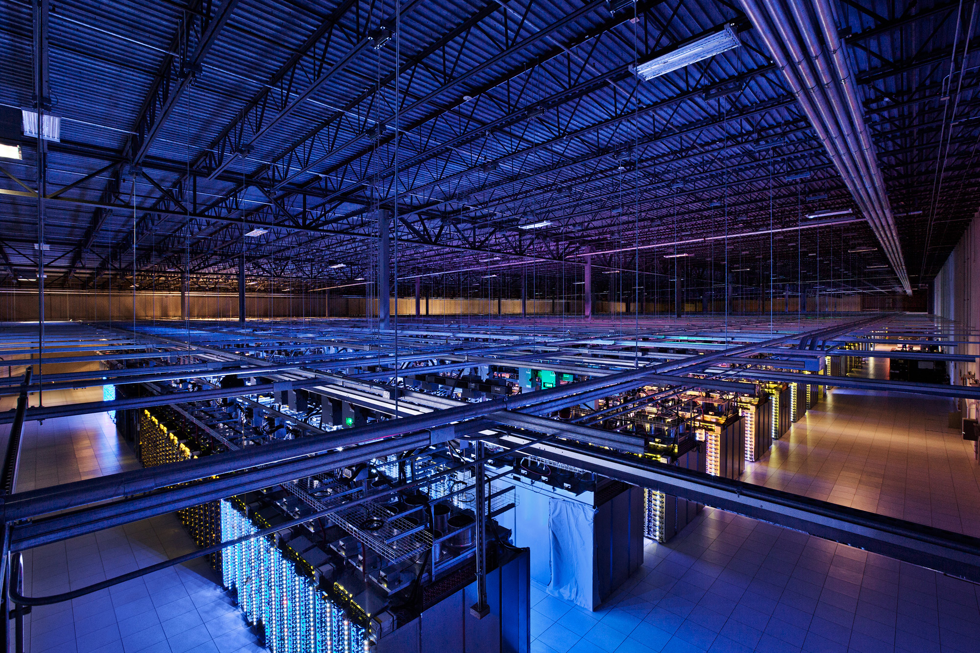
Source: Google

Slide 23
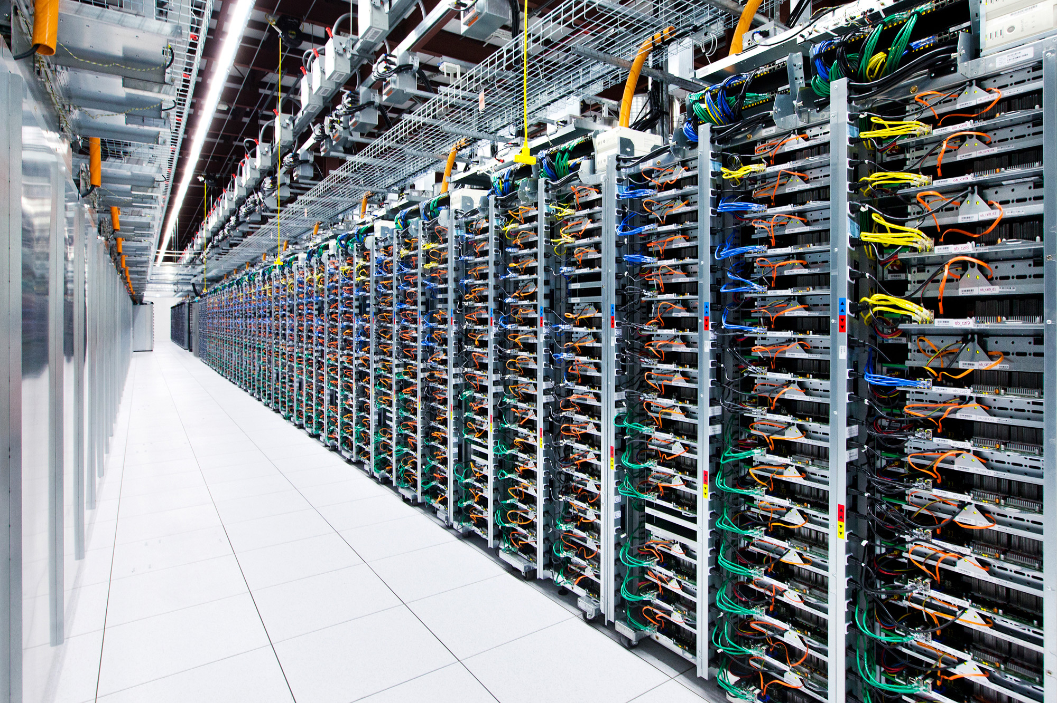
Source: Google

Slide 24

Source: Facebook

Slide 25
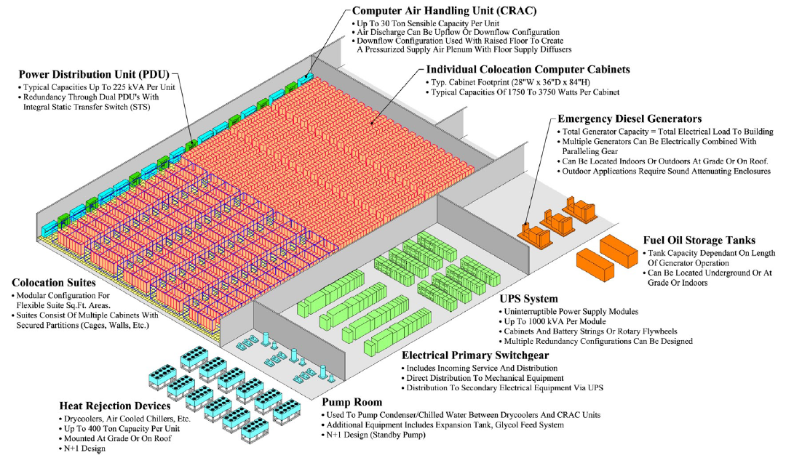
Anatomy of a Datacenter
Source: Barroso and Urs Hölzle (2013)

Slide 26
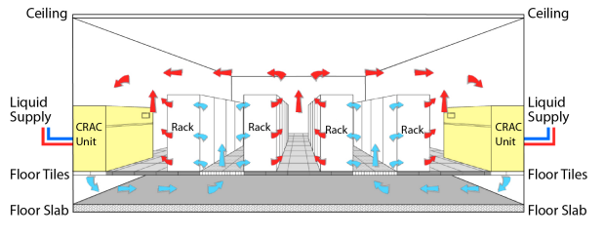
Datacenter cooling
What’s a computer?
Source: Barroso and Urs Hölzle (2013)

Slide 27
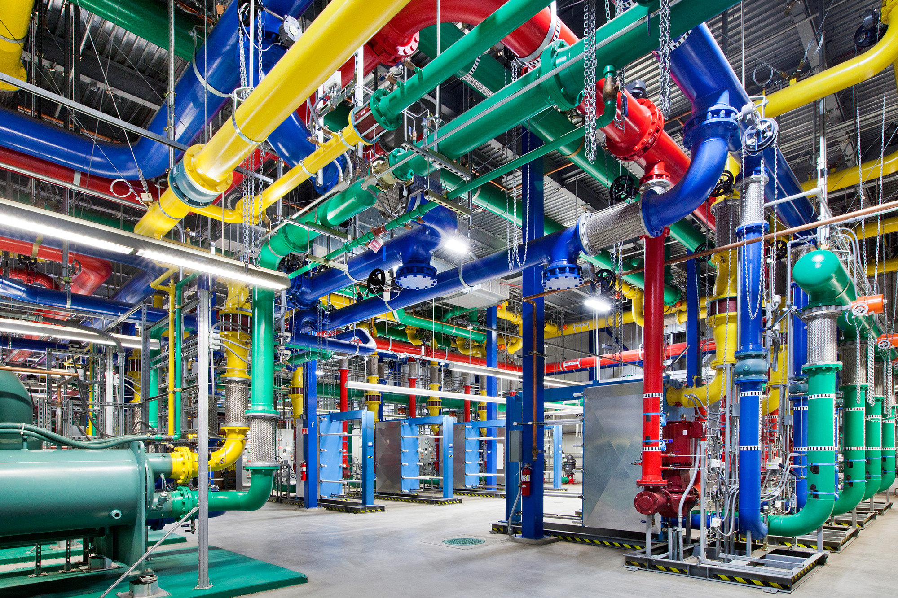
Source: Google

Slide 28
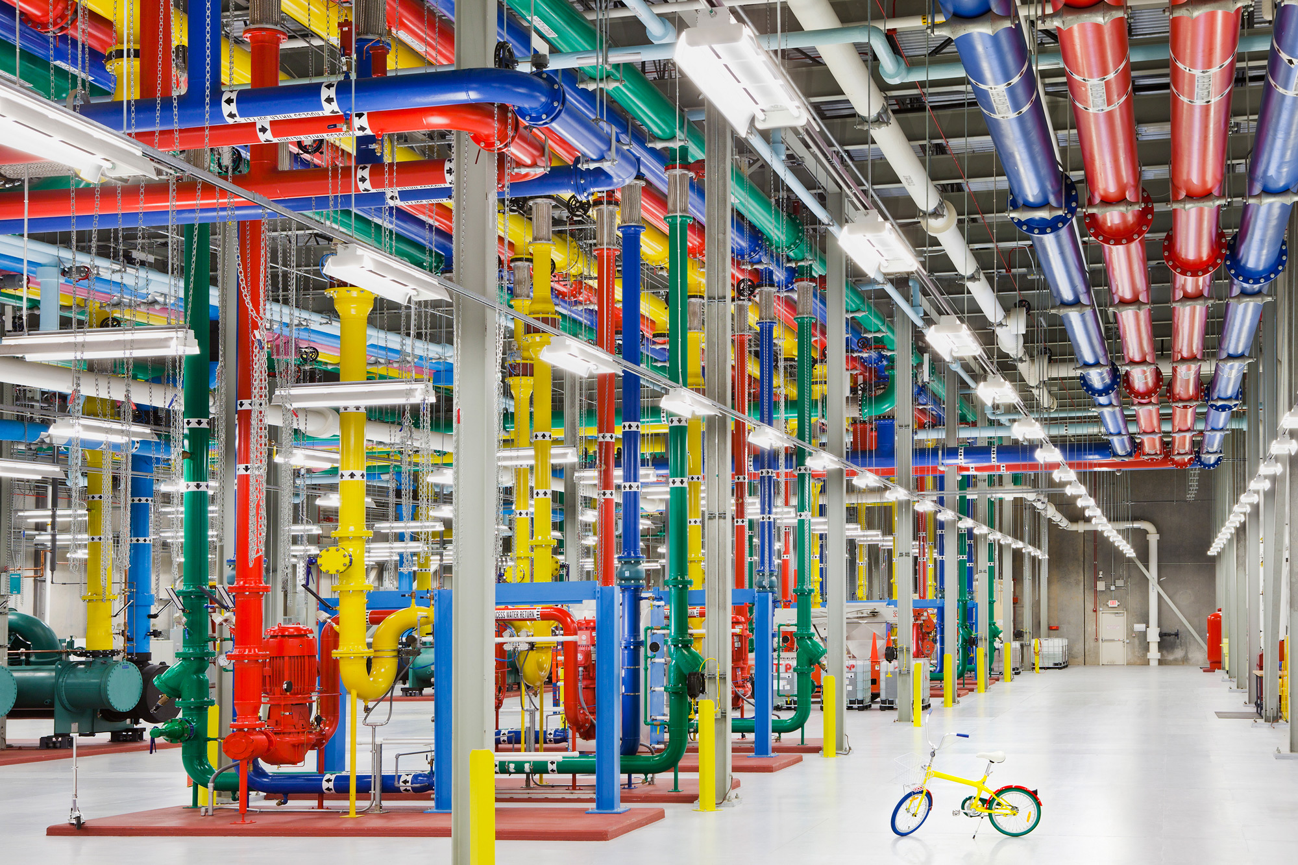
Source: Google

Slide 29
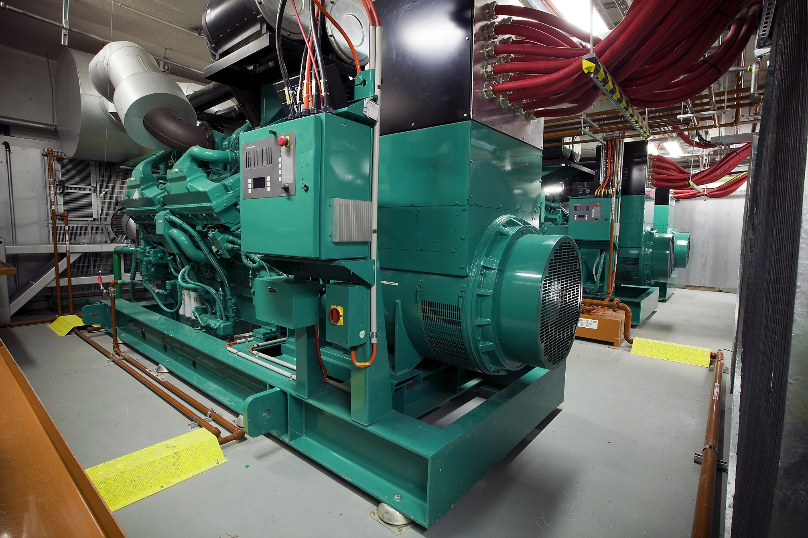
Source: CumminsPower

Slide 30
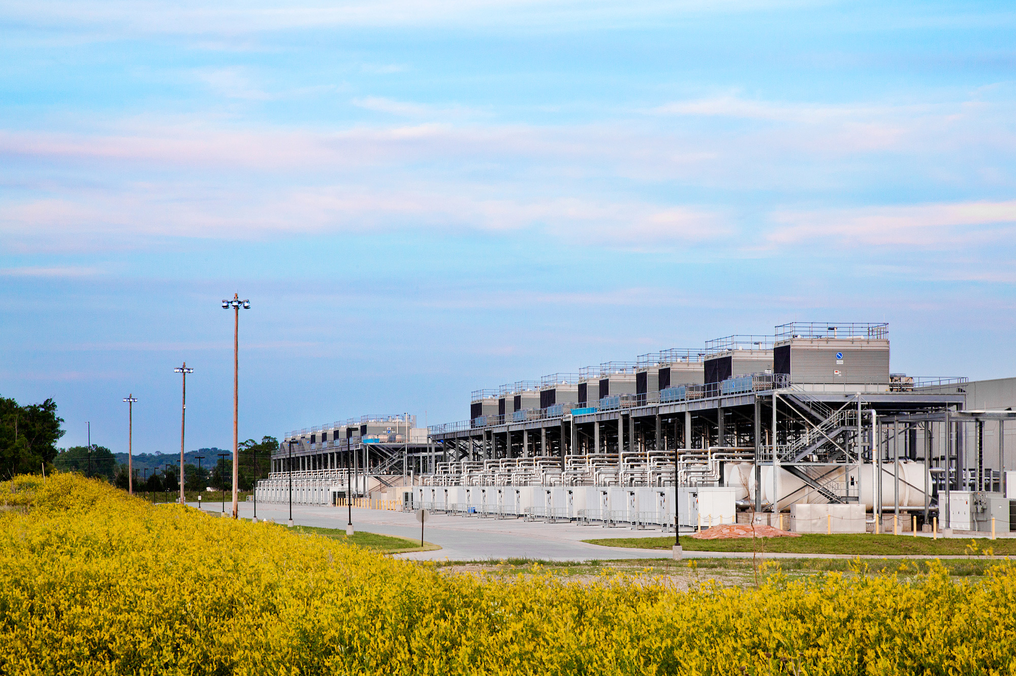
Source: Google

Slide 31
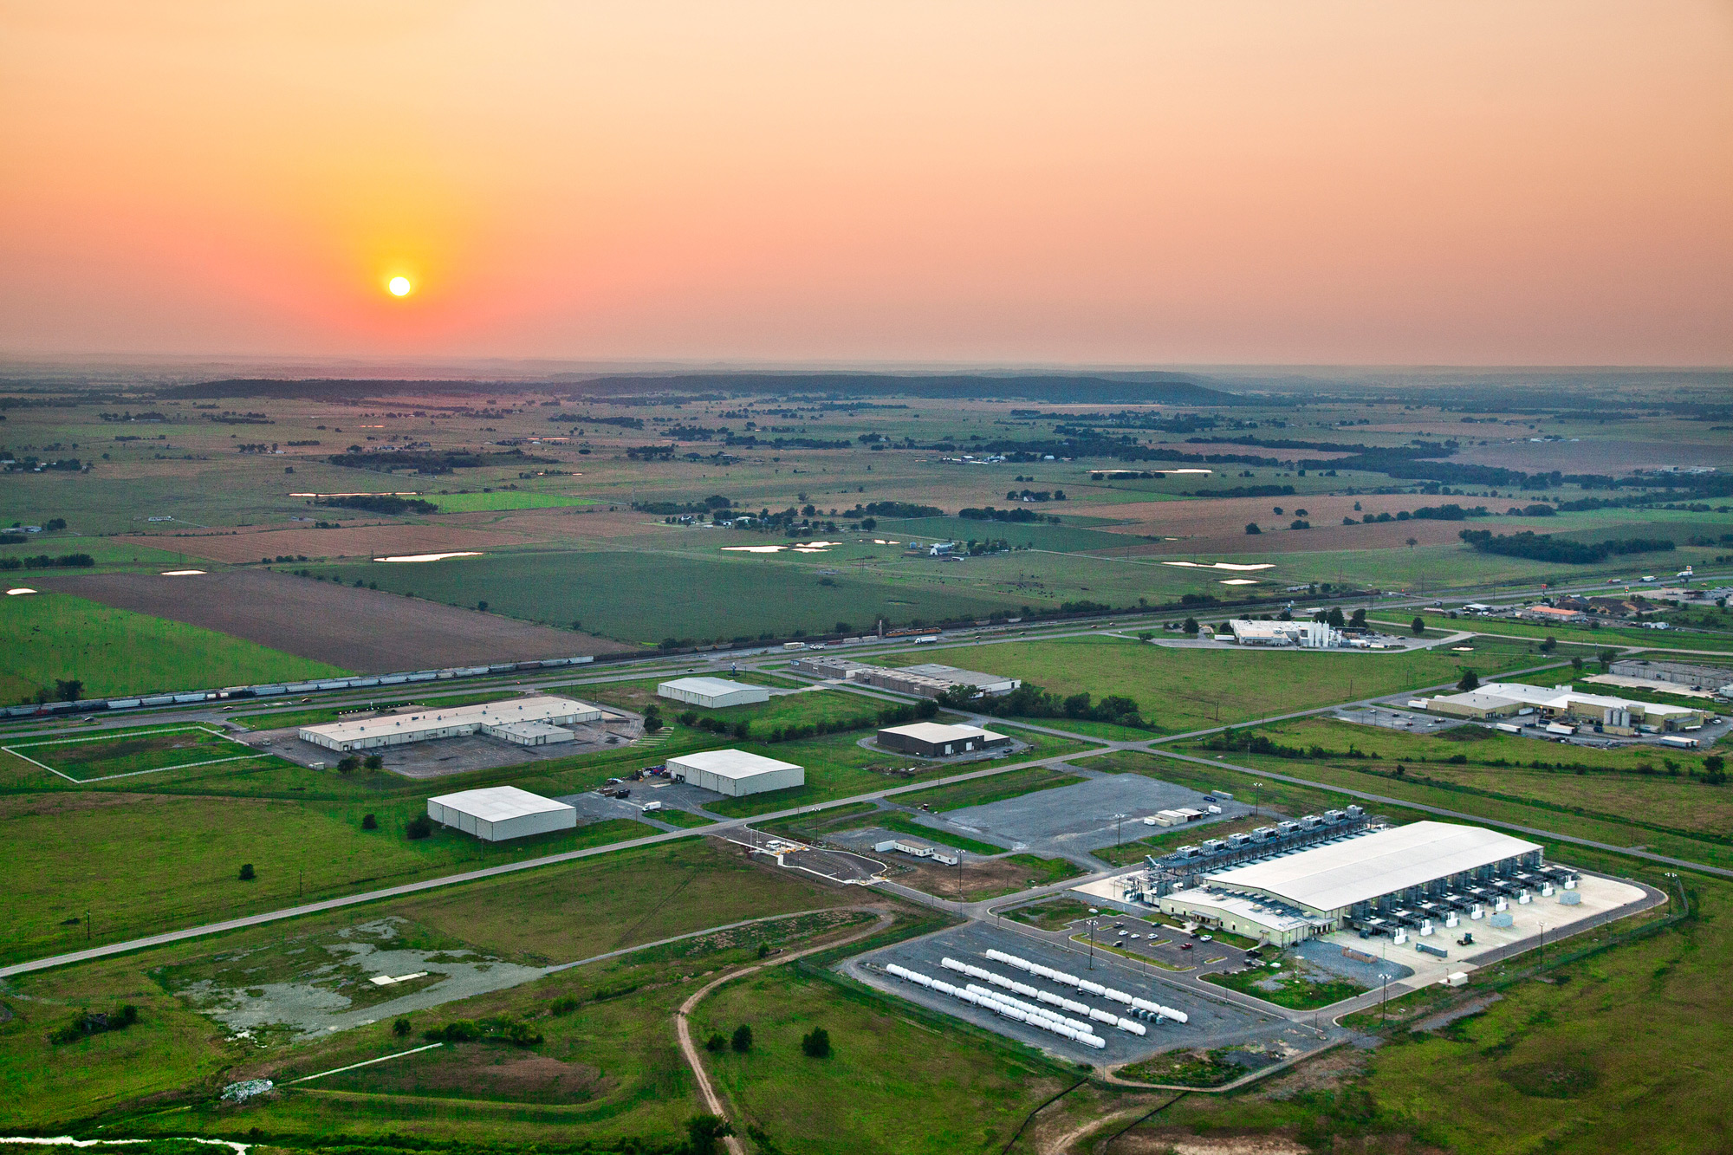
How much is 30 MW?
Source: Google

Slide 32
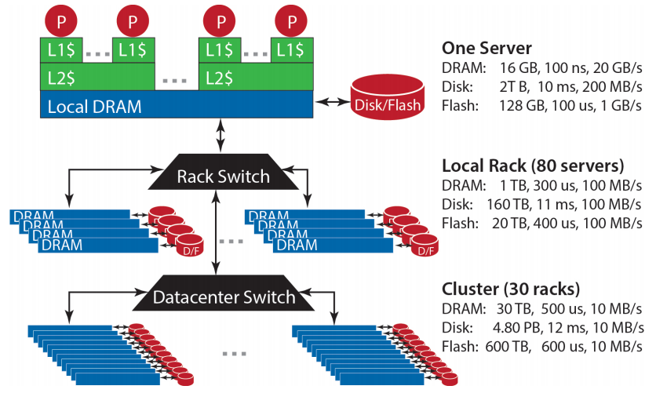
Datacenter Organization
Source: Barroso and Urs Hölzle (2013)

Slide 33
The datacenter is the computer!
It’s all about the right level of abstraction
Moving beyond the von Neumann architecture
What’s the “instruction set” of the datacenter computer?
Hide system-level details from the developers
No more race conditions, lock contention, etc.
No need to explicitly worry about reliability, fault tolerance, etc.
Separating the what from the how
Developer specifies the computation that needs to be performed
Execution framework (“runtime”) handles actual execution
Wait, why do we care?

Slide 34

Mechanical Sympathy
Data Science
Tools
“You don’t have to be an engineer to be be a racing driver, but you do have to have mechanical sympathy”
– Formula One driver Jackie Stewart
This Course
Analytics Infrastructure
Execution Infrastructure
“big data stack”

Slide 35
Intuitions of time and space
How long does it take to read 100 TBs from 100 hard drives?
Now, what about SSDs?
How long will it take to exchange 1b key-value pairs:
Between machines on the same rack?
Between datacenters across the Atlantic?

Slide 36
Storage Hierarchy
Remote Machine
Different Datacenter
Remote Machine
Different Rack
Remote Machine
Same Rack
Local Machine
L1/L2/L3 cache, memory, SSD, magnetic disks
capacity, latency, bandwidth

Slide 37
According to Jeff Dean

Slide 38
Hadoop Cluster Architecture
Source: Google

Slide 39

How do we get data to the workers?
Let’s consider a typical supercomputer…
SAN
Compute Nodes

Slide 40
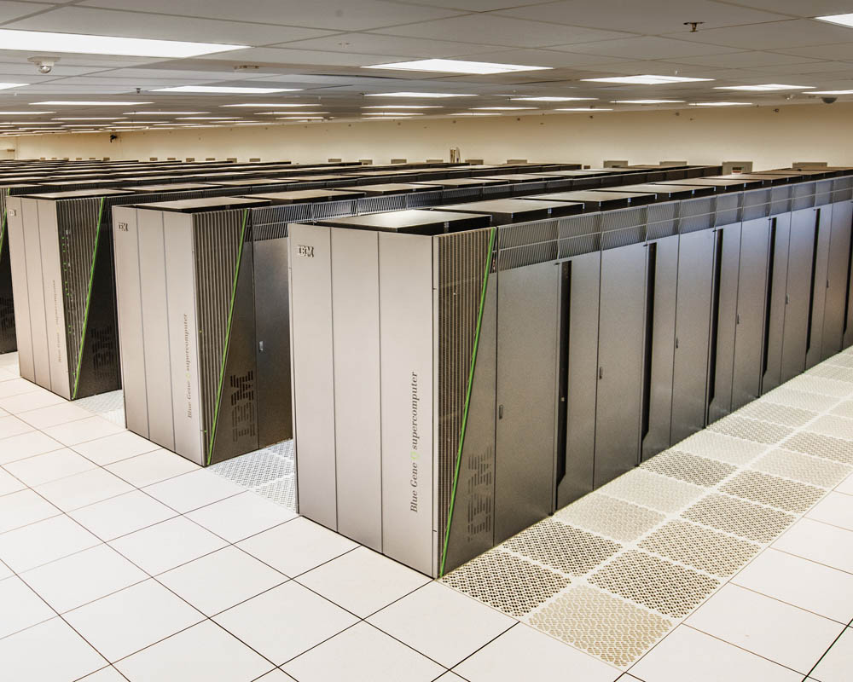
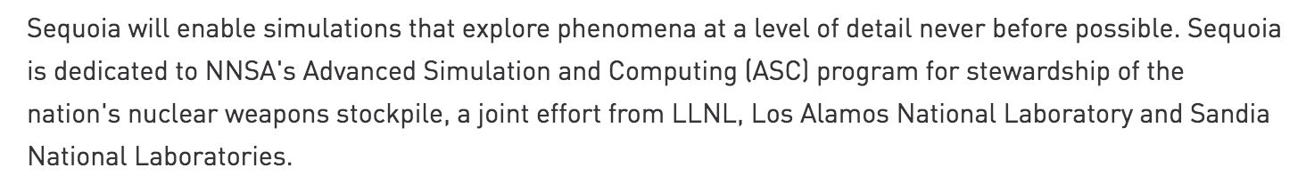
Sequoia
16.32 PFLOPS
98,304 nodes with 1,572,864 million cores 1.6 petabytes of memory
7.9 MWatts total power
Deployed in 2012, still #6 in TOP500 List (November 2017)

Slide 41
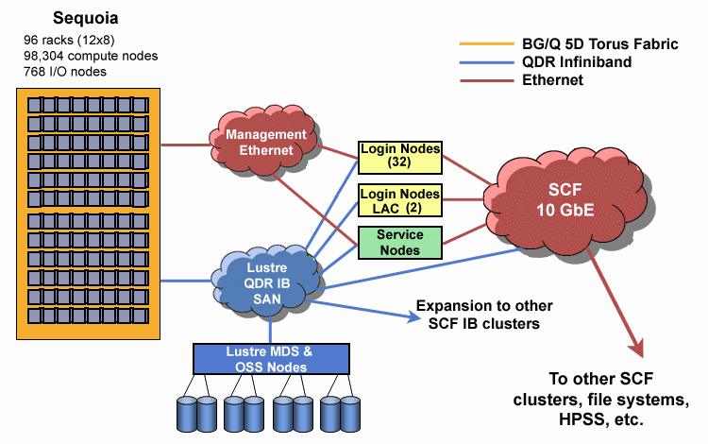
1.6 PB RAM
55 PB ZFS
Source: LLNL

Slide 42
Compute-Intensive vs. Data-Intensive
SAN
Compute Nodes
Why does this make sense for compute-intensive tasks?
What’s the issue for data-intensive tasks?

Slide 43
What’s the solution?
Don’t move data to workers… move workers to the data!
Key idea: co-locate storage and compute
Start up worker on nodes that hold the data
SAN
Compute Nodes

Slide 44
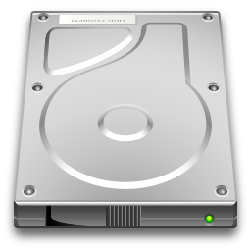
What’s the solution?
Don’t move data to workers… move workers to the data!
Key idea: co-locate storage and compute
Start up worker on nodes that hold the data
We need a distributed file system for managing this
GFS (Google File System) for Google’s MapReduce
HDFS (Hadoop Distributed File System) for Hadoop

Slide 45
GFS: Assumptions
Commodity hardware over “exotic” hardware
Scale “out”, not “up”
High component failure rates
Inexpensive commodity components fail all the time
“Modest” number of huge files
Multi-gigabyte files are common, if not encouraged
Files are write-once, mostly appended to
Logs are a common case
Large streaming reads over random access
Design for high sustained throughput over low latency
GFS slides adapted from material by (Ghemawat et al., SOSP 2003)

Slide 46
GFS: Design Decisions
Files stored as chunks
Fixed size (64MB)
Reliability through replication
Each chunk replicated across 3+ chunkservers
Single master to coordinate access and hold metadata
Simple centralized management
No data caching
Little benefit for streaming reads over large datasets
Simplify the API: not POSIX!
Push many issues onto the client (e.g., data layout)
HDFS = GFS clone (same basic ideas)

Slide 47
From GFS to HDFS
Terminology differences:
GFS master = Hadoop namenode
GFS chunkservers = Hadoop datanodes
Implementation differences:
Different consistency model for file appends
Implementation language
Performance
For the most part, we’ll use Hadoop terminology…

Slide 48
HDFS Architecture
HDFS namenode
Application
/foo/bar
(file name, block id)
File namespace
HDFS Client
block 3df2
(block id, block location)
instructions to datanode
(block id, byte range)
datanode state
HDFS datanode
HDFS datanode
block data
Linux file system
Linux file system
…
…
Adapted from (Ghemawat et al., SOSP 2003)

Slide 49
Namenode Responsibilities
Managing the file system namespace
Holds file/directory structure, file-to-block mapping, metadata (ownership, access permissions, etc.)
Coordinating file operations
Directs clients to datanodes for reads and writes
No data is moved through the namenode
Maintaining overall health
Periodic communication with the datanodes
Block re-replication and rebalancing
Garbage collection

Slide 50
Logical View
k₁
v₁
k₂
v₂
k₃
v₃
k₄
v₄
k₅
v₅
k₆
v₆
map
map
map
map
a
1
b
2
c
3
c
6
a
5
c
2
b
7
c
8
combine
combine
combine
combine
a
1
b
2
c
9
a
5
c
2
b
7
c
8
partition
partition
partition
partition
group values by key
a
1
5
b
2
7
c
2
9
8
*
*
*
reduce
reduce
reduce
r₁
s₁
r₂
s₂
r₃
s₃
* Important detail: reducers process keys in sorted order

Slide 51
Physical View
User Program
(1) submit
Master
(2) schedule map
(2) schedule reduce
worker
split 0
(6) write
output
file 0
split 1
(5) remote read
worker
split 2
(3) read
(4) local write
split 3
worker
split 4
worker
output
file 1
worker
Input
files
Map
phase
Intermediate files
(on local disk)
Reduce
phase
Output
files
Adapted from (Dean and Ghemawat, OSDI 2004)

Slide 52
HDFS namenode
Application
/foo/bar
(file name, block id)
File namespace
HDFS Client
block 3df2
(block id, block location)
instructions to datanode
(block id, byte range)
datanode state
HDFS datanode
HDFS datanode
block data
Linux file system
Linux file system
…
…
Adapted from (Ghemawat et al., SOSP 2003)

Slide 53
Putting everything together…
namenode (NN)
jobtracker (JT)
namenode daemon
jobtracker daemon
tasktracker daemon
tasktracker daemon
tasktracker daemon
datanode daemon
datanode daemon
datanode daemon
Linux file system
Linux file system
Linux file system
…
…
…
worker node
worker node
worker node

Slide 54
*
Basic Cluster Components
Namenode (NN)
Master for HDFS
Jobtracker (JT)
Coordinator for MapReduce jobs
On each of the worker machines:
Tasktracker (TT): contains multiple task slots
Datanode (DN): serves HDFS data blocks
* Not quite… leaving aside YARN for now

Slide 55
Input File
Input File
InputSplit
InputSplit
InputSplit
InputSplit
InputSplit
InputFormat
RecordReader
RecordReader
RecordReader
RecordReader
RecordReader
Mapper
Mapper
Mapper
Mapper
Mapper
Intermediates
Intermediates
Intermediates
Intermediates
Intermediates
What are these input split?
Source: redrawn from a slide by Cloduera, cc-licensed

Slide 56
Client
Records
…
…
InputSplit
InputSplit
InputSplit
RecordReader
RecordReader
RecordReader
Mapper
Mapper
Mapper
What are these input split?

Slide 57
Mapper
Mapper
Mapper
Mapper
Mapper
Intermediates
Intermediates
Intermediates
Intermediates
Intermediates
Partitioner
Partitioner
Partitioner
Partitioner
Partitioner
What’s going on here?
(combiners omitted here)
Intermediates
Intermediates
Intermediates
Reducer
Reducer
Reduce
Source: redrawn from a slide by Cloduera, cc-licensed

Slide 58
Distributed Group By in MapReduce
Map side
Map outputs are buffered in memory in a circular buffer
When buffer reaches threshold, contents are “spilled” to disk
Spills are merged into a single, partitioned file (sorted within each partition)
Combiner runs during the merges
Reduce side
First, map outputs are copied over to reducer machine
“Sort” is a multi-pass merge of map outputs (happens in memory and on disk)
Combiner runs during the merges
Final merge pass goes directly into reducer

Slide 59
Distributed Group By in MapReduce
Mapper
intermediate files (on disk)
merged spills (on disk)
Combiner
Reducer
circular buffer (in memory)
Combiner
other reducers
spills (on disk)
Barrier between map and reduce phases
other mappers
But runtime can begin copying intermediate data earlier

Slide 60
k₁
v₁
k₂
v₂
k₃
v₃
k₄
v₄
k₅
v₅
k₆
v₆
map
map
map
map
a
1
b
2
c
3
c
6
a
5
c
2
b
7
c
8
combine
combine
combine
combine
a
1
b
2
c
9
a
5
c
2
b
7
c
8
partition
partition
partition
partition
group values by key
a
1
5
b
2
7
c
2
9
8
*
*
*
reduce
reduce
reduce
Why?
r₁
s₁
r₂
s₂
r₃
s₃
* Important detail: reducers process keys in sorted order

Slide 61
Law of Leaky Abstractions
All non-trivial abstractions, to some degree, are leaky.
Joel Spolsky
Remember logical vs. physical?

Slide 62
Questions?
Remember: Assignment 0 due next session – you must tell us if you wish to take the late penalty.
Source: Wikipedia (The Scream)

